Slide 1

Case Study – Supply Chain Optimization: Reporting & Analytics
Presented By,
PRACHI SINGH SENGAR

Slide 2
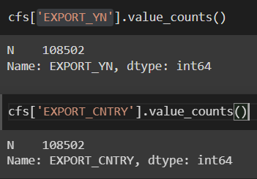
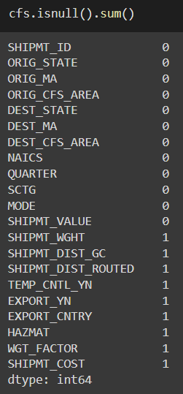
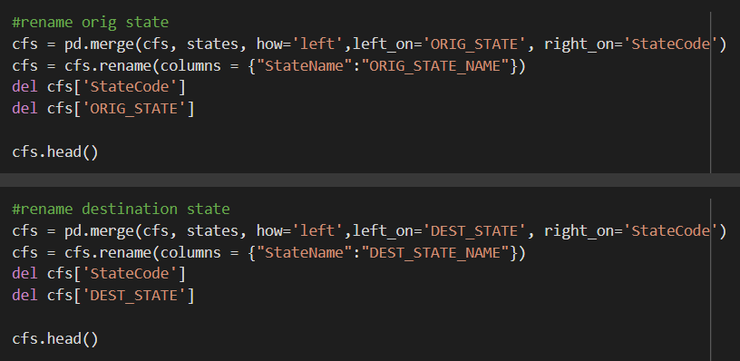

FINAL DATABASE
Merging and renaming columns to create the final dataset:
The columns “EXPORT_YN” & “EXPORT_CNTRY” were dropped
INTERESTING FINDINGS:
Shipment Value: Median - $9979
Mean - $20592
Max - $199905
Shipment Weight: Median- 29k Pounds
Mean – 27k Pounds
Max – 49k Pounds
Not many Null Values

Slide 3
PART 1 - DATA MANAGEMENT AND ANALYSIS
Question 1: Which are the American States with the most exchanges of products based on weight?
Question 2: Which Industries ship more goods across the US?
Question 3: What type of goods are the most shipped across the US?
Question 4: Knowing that company xyz belong to the Industrial Classification "Electrical equipment, appliance, and component manufacturing", and we mainly ship "Electronic and Other Electrical Equipment and Components, and Office Equipment" how this subset compares with the rest?
Question 5: What are the drivers of the shipment cost given the dataset provided?
Question 6: What could be some metrics to compare the various industries? explain how they are defined and why they are important
Question 7: How company xyz industry compares to the others based on the metrics defined before

Slide 4
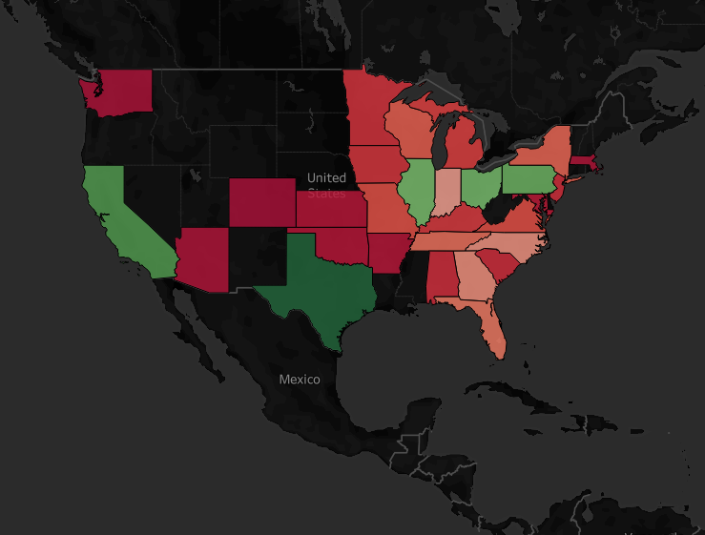
STATES WITH MOST EXCHANGES OF PRODUCTS BASED ON WEIGHT
Texas
California
Ohio
Pennsylvania
Illinois
Indiana
North Carolina

Slide 5
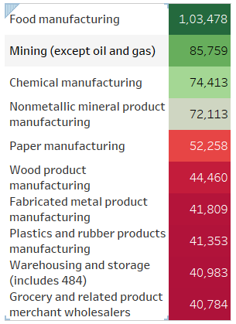
INDUSTRIES WHICH SOLD THE MOST PRODUCTS
It appears that America likes to ship most products related to Food, Chemicals and lots of Metals!!!

Slide 6
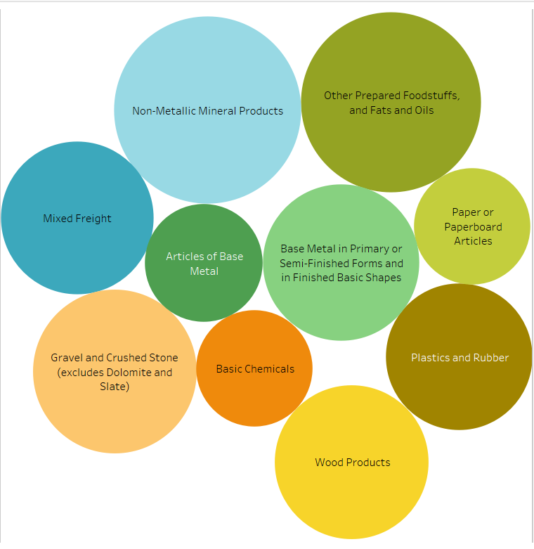
MOST SHIPPED GOODS
The Food, Metals and Plastics and Rubber items seem to be sold in a large quantity !!

Slide 7
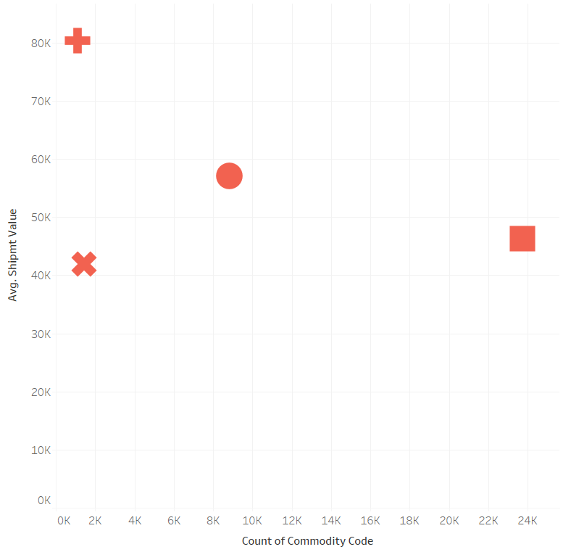
COMPARISON OF COMPANY XYZ WITH OTHER INDUSTRIES

Slide 8
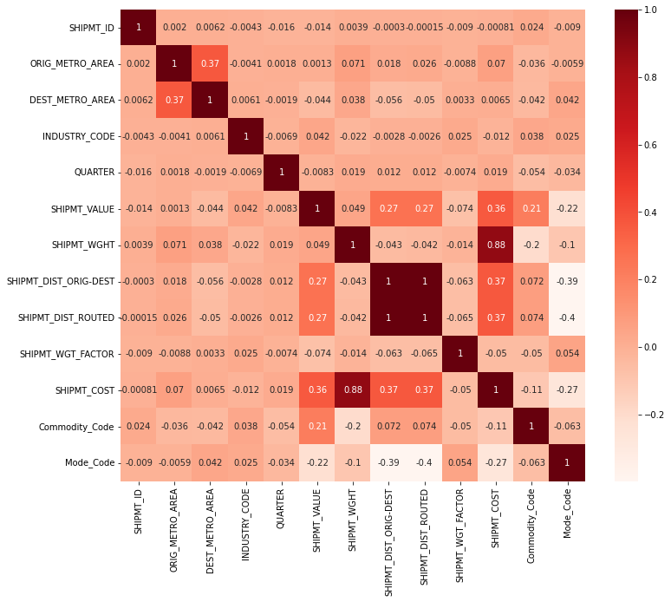
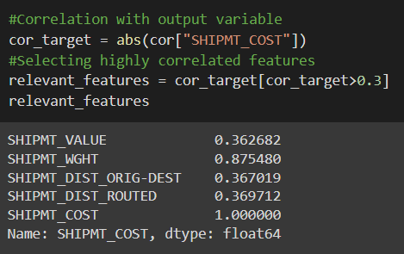
DRIVERS OF SHIPMENT COST

Slide 9
METRICS TO COMPARE THE VARIOUS INDUSTRIES
METRICS
Avg. Shipment Value
Cost Per Shipment
Avg. Shipment Weight
Total Num of Shipments
Mode of Transport
Avg. Delivery (Routed) Distance

Slide 10
COMPARING OTHER INDUSTRIES vs XYZ
METRICS | INDUSTRIES | XYZ
Number of Products Shipped | Highest products sales were for food Manufacturing and most goods sold were between 80k to 10k | Comparatively we have less sales
Average Shipment Value | Most of the industries belonged to the Machinery and Equipment manufacturing ($51k to $62k) | The value is $57k
Average Shipment Weight | Heaviest products were transferred for Mining (37k Pounds) | The products transported had an avg weight of 20k Pounds
Cost Per Shipment | Most shipments have a cost between $2000 to $4200 per shipment | $3720/ shipment – reasonable as the value generated is also better
Maximum mode of Transport | Most of the Industries chose to hire a Private truck to transfer their items | XYZ most preferable mode was Private truck as well
Avg. Delivery (Routed) Distance | Most Distances have their distance traveled below 400 miles | The distance travelled was 709 miles

Slide 11
PART 2: ANALYTICS AND TOOLS
Question 1: Which tools did you choose to complete the analysis and why did you choose them
Question 2: Company XYZ, has to choose a new tool to improve the ability of the users to analyze data in order to speed up the decision making process.
- How would you approach this decision?
- What are the criteria you would use to choose the suite?
- What would be the steps you would follow in order to implement the new tool in the most effective way?
Question 3: Intrigued by your analysis on shipment costs, XYZ decided to explore more the field of analytics applied to transportation cost optimization and would like to move from some report to something that could better support the decision. You have been asked to propose some technologies or suppliers. How would you approach the request?

Slide 12
TOOLS USED FOR THE ANALYSIS
PYTHON
TABLEAU
MICROSOFT EXCEL

Slide 13
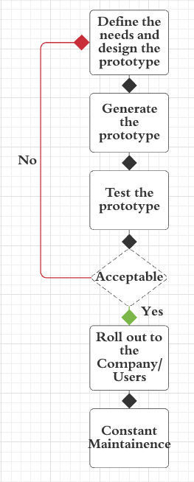
NEW TOOL SUGGESTION FOR DECISION - MAKING
Problem definition
Brainstorm ideas
Select Optimal solutions
Set deadline/ Budget/ Users
Design -> Receive feedback
Rollout tool
Documentation/Maintenance
Recognize the need/ Features
Easy to use/ Interoperable
Budget Friendly
Will it meet future needs?

Slide 14
TRANSPORT COST OPTIMIZATION
Reasons for High Cost of Transportation:
High freight rates: Larger distance between Origin and Destination
Shipping to remote locations
Split shipments (Improper order management)
Not taking an optimized route
Inappropriate Warehouse locations
Weight Limitations of the shipment
WELCOME TO TRAVIZ !!!

Slide 15
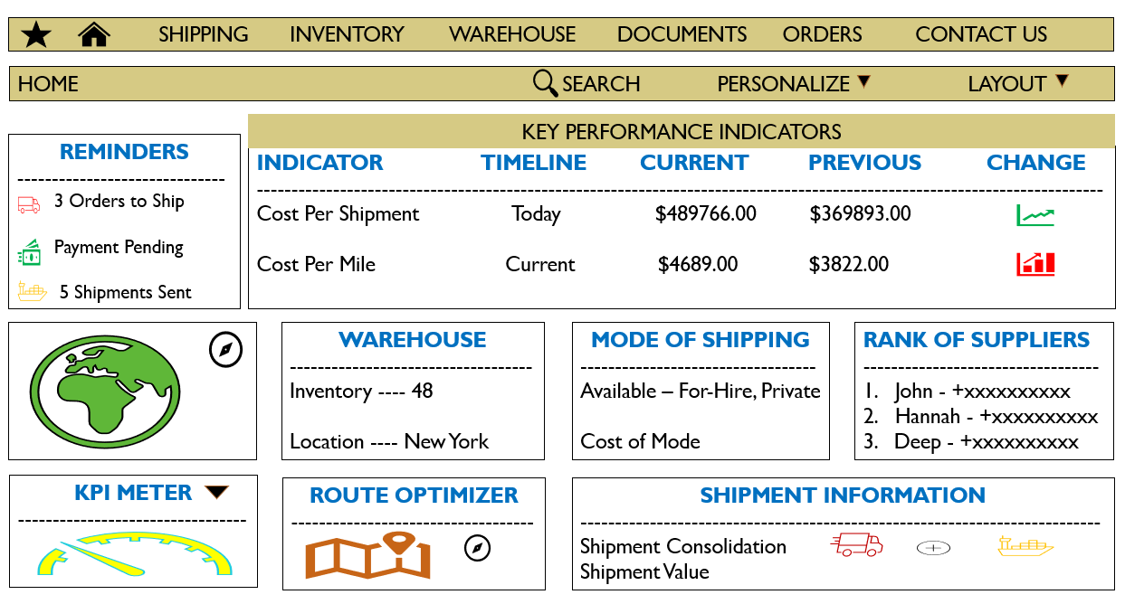

Slide 16

THANK YOU !!!

